Slide 1
Frames
Frames are a relatively new addition to the HTML standard. First introduced in Netscape Navigator 2.0.
Objectives:
Upon completing this section, you should be able to:
Create a Frame based page.
Work with the Frameset, Frame, and Noframes elements.
Use the attributes of the Frames elements to control the display.
Set Targets appropriately.

Slide 2
Frames
A framed page is actually made up of multiple HTML pages. There is one HTML document that describes how to break up the single browser window into multiple windowpanes. Each windowpane is filled with an HTML document.
For Example to make a framed page with a windowpane on the left and one on the right requires three HTML pages. Doc1.html and Doc2.html are the pages that contain content. Frames.html is the page that describes the division of the single browser window into two windowpanes.

Slide 3
Frames
Doc1.html
Doc2.html
Doc1.html
Doc2.html
Frames.html

Slide 4
Frame Page Architecture
A <FRAMESET> element is placed in the html document before the <BODY> element. The <FRAMESET> describes the amount of screen real estate given to each windowpane by dividing the screen into ROWS or COLS.
The <FRAMESET> will then contain <FRAME> elements, one per division of the browser window.
Note: Because there is no BODY container, FRAMESET pages can't have background images and background colors associated with them.

Slide 5
Frame Page Architecture
<HTML>
<HEAD>
<TITLE> Framed Page </TITLE>
<FRAMeSET COLS=“23%,77%”>
<FRAME SRC=“Doc1.html”>
<FRAME SRC=“Doc2.html”>
</FRAMeSET >
</HEAD>
</HTML>

Slide 6
The Diagram below is a graphical view of the document described above
FRAMESET COLS=”23%, 77%”
FRAME
NAME= left_pane
SRC=Doc1.html
FRAME
NAME=right_pane
SRC= Doc2.html

Slide 7
<FRAMESET> Container
<FRAMESET> : The FRAMESET element creates divisions in the browser window in a single direction. This allows you to define divisions as either rows or columns.
ROWS : Determines the size and number of rectangular rows within a <FRAMESET>. They are set from top of the display area to the bottom.
Possible values are:
Absolute pixel units, I.e. “360,120”.
A percentage of screen height, e.g. “75%,25%”.
Proportional values using the asterisk (*). This is often combined with a value in pixels , e.g. “360,*”.
<Frameset cols=“200,20%,*,2*”>

Slide 8
Creating a Frames Page
COLS: Determines the size and number of rectangular columns within a <FRAMESET>. They are set from left to right of the display area.
Possible values are:
Absolute pixel units, I.e. “480,160”.
A percentage of screen width, e.g. “75%,25%”.
Proportional values using the asterisk (*). This is often combined with a value in pixels , e.g. “480,*”.

Slide 9
Creating a Frames Page
FRAMEBORDER : Possible values 0, 1, YES, NO. A setting of zero will create a borderless frame.
FRAMESPACING: This attribute is specified in pixels. If you go to borderless frames you will need to set this value to zero as well, or you will have a gap between your frames where the border used to be.
BORDER(thickness of the Frame): This attribute specified in pixels. A setting of zero will create a borderless frame. Default value is 5.
BORDERCOLOR: This attribute is allows you choose a color for your border. This attribute is rarely used.

Slide 10
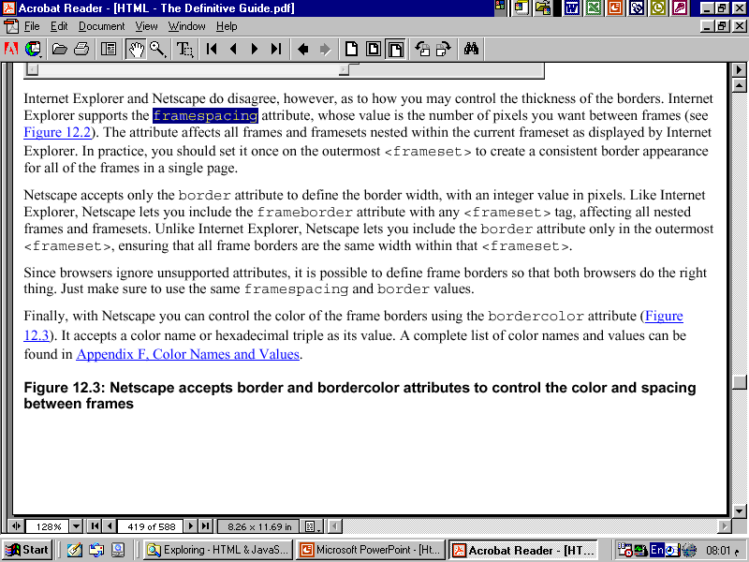

Slide 11
<FRAME>
<FRAME>: This element defines a single frame within a frameset. There will be a FRAME element for each division created by the FRAMESET element. This tag has the following attributes:
SRC: Required, as it provides the URL for the page that will be displayed in the frame.
NAME: Required for frames that will allow targeting by other HTML documents. Works in conjunction with the target attribute of the <A>, <AREA>, <BASE>, and <FORM> tags.

Slide 12
<FRAME>
MARGINWIDTH: Optional attribute stated in pixels. Determines horizontal space between the <FRAME> contents and the frame’s borders.
MARGINHEIGHT: Optional attribute stated in pixels. Determines vertical space between the <FRAME> contents and the frame’s borders.
SCROLLING: Displays a scroll bar(s) in the frame. Possible values are:
Yes – always display scroll bar(s).
No – never display scroll bar(s).
Auto – browser will decide based on frame contents.
By default: scrolling is auto.

Slide 13
<FRAME>
NORESIZE: Optional – prevents viewers from resizing the frame. By default the user can stretch or shrink the frame’s display by selecting the frame’s border and moving it up, down, left, or right.

Slide 14
<NOFRAMES>
<NOFRAMES>: Frame – capable browsers ignore all HTML within this tag including the contents of the BODY element. This element does not have any attributes.
<HTML>
<HEAD>
<TITLE> Framed Page </TITLE>
</HEAD>

Slide 15
<NOFRAMES>
<FRAMESET COLS="23%,77%">
<FRAME SRC="" NAME="left_pane“>
<FRAME SRC="" NAME="right_pane">
<NOFRAMES>
<P> This is a Framed Page. Upgrade your browser to support frames.</P>
</NOFRAMES></FRAMESET>

Slide 16
Compound FRAMESET Divisions
In this case a second FRAMESET element will be inserted in the place of the FRAME element that would describe the second row.
The second FRAMESET element will divide the remaining screen real estate into 2 columns.
This nested FRAMESET will then be followed by 2 FRAME elements to describe each of the subsequent frame divisions created.

Slide 17
Compound FRAMESET Divisions
<html>
<head>
<title> Compound Frames Page</title>
</head>
<frameset rows=“120,*”>
<frame src=“banner_file.html” name”banner”>
<frameset cols=“120,*”>
<frame src=“links_file.html” name=“links”>
<frame src=“content_file.html” name=“content”>
<noframes>
<p>
Default message
</p>
</noframes>
</frameset>
</frameset>
</head>

Slide 18
Compound FRAMESET Divisions
You may want to create a frames design with a combination of rows and columns.
Banner File
Links
File
Contents File

Slide 19
Compound FRAMESET Divisions Example
<HEAD>
<FRAMESET ROWS="25%,50%,25%”
<FRAME SRC="">
<FRAMESET COLS="25%,*">
<FRAME SRC="">
<FRAME SRC="">
</FRAMESET>
<FRAME SRC="">
</FRAMESET>
</HEAD>

Slide 20
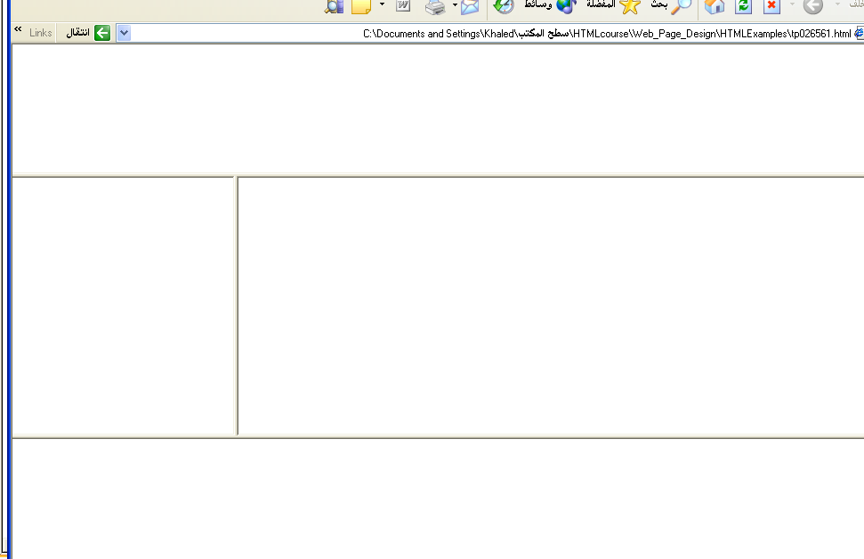
Output

Slide 21
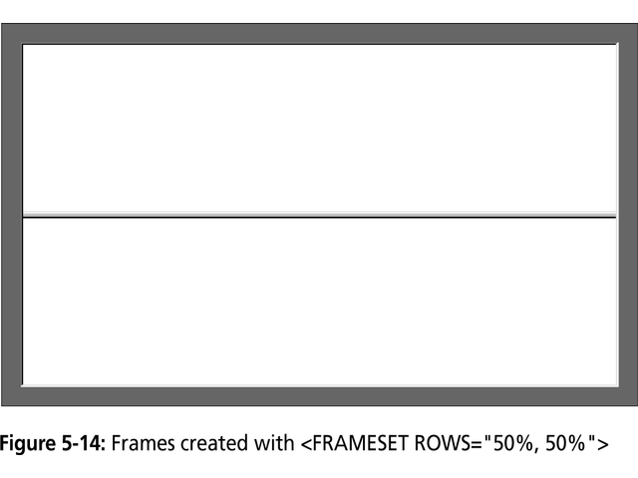

Slide 22
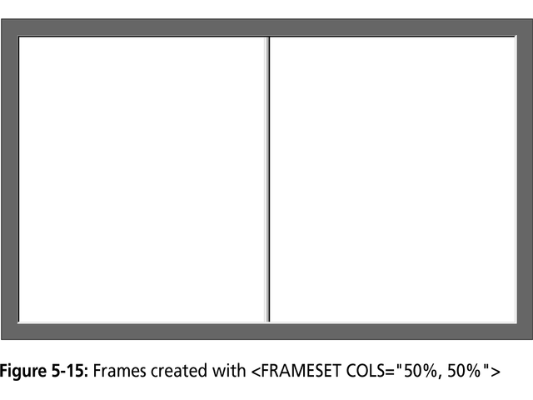

Slide 23
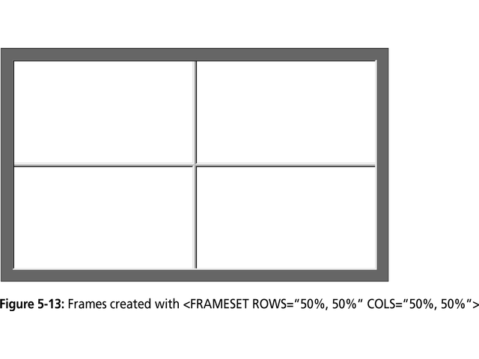

Slide 24
Frame Formatting
Example:
    <frameset rows=“20%, *, 20%”>
    <frame src=“header.html” noresize scrolling=no>
    <frame src=“body.html”>
    <frame src=“navigationbar.html” noresize scrolling=no>
    </frameset>

Slide 25
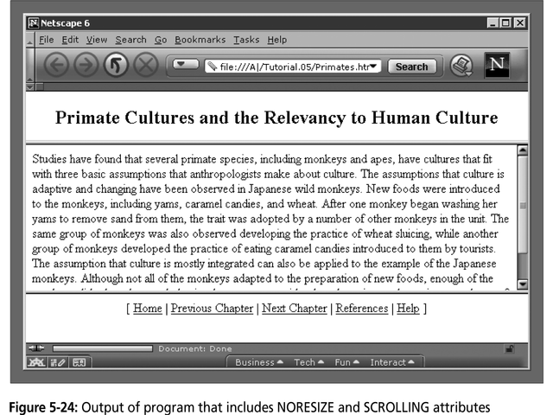

Slide 26
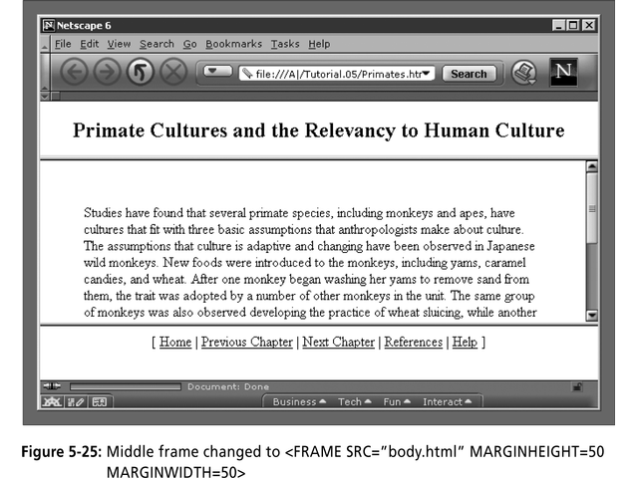

Slide 27
What do the following mean?
<FRAMESET COLS="2*, 3*, 5*">
2) <FRAMESET COLS="150, 20%, *, 3*">
So what are the space-allocation priorities? Absolute pixel values are always assigned space first, in order from left to right. These are followed by percentage values of the total space. Finally, proportional values are divided based upon what space is left.

Slide 28
Generic Frame Formula
The <FRAME> tag has six associated attributes: SRC, NAME, MARGINWIDTH, MARGINHEIGHT, SCROLLING, and NORESIZE. Here's a complete generic FRAME:
<FRAME SRC="url" NAME="window_name" SCROLLING=YES|NO|AUTO MARGINWIDTH="value" MARGINHEIGHT="value"
NORESIZE>

Slide 29
What will be the Output?
<FRAMESET ROWS="*, 2*, *" COLS="2*, *">
<FRAME SRC=“”>
<FRAME SRC=“”>
<FRAME SRC=“”>
<FRAME SRC=“”>
<FRAME SRC=“”>
<FRAME SRC=“”>
</FRAMESET>

Slide 30
Targets
When you use links for use in a frames environment you will need to specify an additional attribute called TARGET.
The TARGET attribute uses the NAME attribute of the FRAME element.
If we were to place a link in doc1.html that linked to doc3.html and we wanted doc3.html to be displayed in the right windowpane; the HTML code would appear in doc1.html as follows:
<A HREF=“doc3.html” TARGET=“right_pane”>Link to Document 3 </A>

Slide 31
Special Targets
There are 4 special target names that cannot be assigned by the NAME attribute of the FRAME tag.
1. TARGET=“_top” : This loads the linked document into the full browser window with the URL specified by the HREF attribute. All frames disappear, leaving the new linked page to occupy the entire window. The back is turned on.
2. TARGET=“_blank” : Opens an unnamed new browser window and loads the document specified in the URL attribute into the new window (and your old window stays open). The back is turned off. Other windows remains on.
3. TARGET=“_self” : Loads the document in the same window where the anchor was {Clicked}. This is the default setting for linking elements.
4. TARGET=“_parent” : the _parent frame is a prior frameset that the current frameset was “spawned” from. If there isn’t one it is the browser window. The document is loaded into the area occupied by the columns or rows frameset containing the frame that contains the link. The back is turned on. All windows disappear.

Slide 32
If a frame contains the following link, then clicking the link launches a new, unnamed browser display window that contains the content defined in stuff.HTM. This can be a simple HTML document, or an entirely new FRAMESET definition.
1. <A HREF="stuff.html" TARGET="_blank">
If a frame contains the following link, then clicking the link will simply cause the frame which contains the link to clear, and its content will be replaced with whatever is in stuff.htm.
2. <A HREF="stuff.html" TARGET="_self">
If a frame contains the following link, the frameset that contains the frame that contains this link will be replaced by stuff.HTM.
3. <A HREF="stuff.html" TARGET="_parent">
Finally, if a frame contains the following link, clicking the link replaces the entire browser window with the contents of stuff.HTM.
4. <A HREF="stuff.html" TARGET="_top">

Slide 33
Targeting links to frames
The TARGET attribute allows you to specify the frame into which a page is to be loaded into in a frames setting.
<A HREF=“chap1.html” TARGET=“_self”> [Chapter 1]</A>
<A HREF=“chap1.html” TARGET=“_parent”> [Chapter 2]</A>
Parent window
chap1.html
Learning HTML
[Chapter 1][Chapter 2][Chapter 3]
chap2.html

Slide 34
Targeting links to frames
The TARGET attribute allows you to specify the frame into which a page is to be loaded into in a frames setting.
<A HREF=“chap1.html” TARGET=“bottom”> [Chapter 1]</A>
<A HREF=“chap2.html” TARGET=“bottom”> [Chapter 2]</A>
<A HREF=“chap3.html” TARGET=“bottom”> [Chapter 3]</A>
chap1.html
Learning HTML
[Chapter 1][Chapter 2][Chapter 3]
chap2.html
chap3.html

Slide 35
Forms
Forms add the ability to web pages to not only provide the person viewing the document with dynamic information but also to obtain information from the person viewing it, and process the information.
Objectives:
Upon completing this section, you should be able to
Create a FORM.
Add elements to a FORM.
Define CGI (Common Gateway Interface).
Describe the purpose of a CGI Application.
Specify an action for the FORM.
Forms work in all browsers.
Forms are Platform Independent.

Slide 36
Forms
To insert a form we use the <FORM></FORM> tags. The rest of the form elements must be inserted in between the form tags.
<HTML> <HEAD>
<TITLE> Sample Form</TITLE>
</HEAD>
<BODY BGCOLOR=“FFFFFF”>
<FORM ACTION = http://www.xnu.com/formtest.asp>
<P> First Name: <INPUT TYPE=“TEXT” NAME=“fname” MAXLENGTH=“50”> </P>
<P> <INPUT TYPE=“SUBMIT” NAME=“fsubmit1” VALUE=“Send Info”> </P>
</FORM>
</BODY> </HTML>

Slide 37
<FORM> element attributes
ACTION: is the URL of the CGI (Common Gateway Interface) program that is going to accept the data from the form, process it, and send a response back to the browser.
METHOD: GET (default) or POST specifies which HTTP method will be used to send the form’s contents to the web server. The CGI application should be written to accept the data from either method.
NAME: is a form name used by VBScript or
JavaScripts.
TARGET: is the target frame where the response page will show up.

Slide 38
Form Elements
Form elements have properties: Text boxes, Password boxes, Checkboxes, Option(Radio) buttons, Submit, Reset, File, Hidden and Image.
The properties are specified in the TYPE Attribute of the HTML element <INPUT></INPUT>.

Slide 39
Form Elements
<INPUT> Element’s Properties
TYPE= Type of INPUT entry field.
NAME = Variable name passed to CGI application
VALUE= The data associated with the variable name to be passed to the CGI application
CHECKED= Button/box checked
SIZE= Number of visible characters in text field
MAXLENGHT= Maximum number of characters accepted.

Slide 40

Text Box
Text boxes: Used to provide input fields for text, phone numbers, dates, etc.
<INPUT TYPE= " TEXT " >
Browser will display
Textboxes use the following attributes:
TYPE: text.
SIZE: determines the size of the textbox in characters. Default=20 characters.
MAXLENGHT : determines the maximum number of characters that the field will accept.
NAME: is the name of the variable to be sent to the CGI application.
VALUE: will display its contents as the default value.

Slide 41
Example on Text Box
<TITLE>Form_Text_Type</TITLE>
</HEAD> <BODY>
<h1> <font color=blue>Please enter the following bioData</font></h1>
<FORM name="fome1" Method= " get " Action= " URL " >
First Name: <INPUT TYPE="TEXT" NAME="FName"
SIZE="15" MAXLENGTH="25"><BR>
Last Name: <INPUT TYPE="TEXT" NAME="LName"
SIZE="15" MAXLENGTH="25"><BR>
Nationality: <INPUT TYPE="TEXT" NAME="Country"
SIZE="25" MAXLENGTH="25"><BR>
The Phone Number: <INPUT TYPE="TEXT" NAME="Phone"
SIZE="15" MAXLENGTH="12"><BR>
</FORM> </BODY> </HTML>

Slide 42
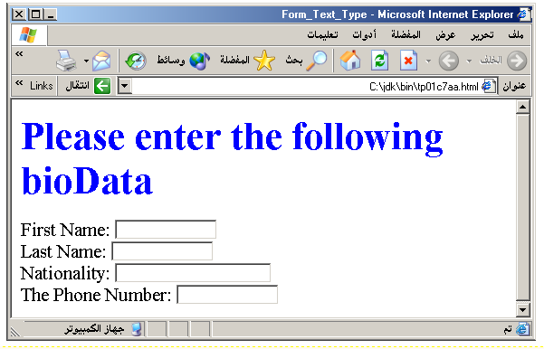
Output

Slide 43
Password
Password: Used to allow entry of passwords.
<INPUT TYPE= " PASSWORD " >
Browser will display
Text typed in a password box is starred out in the browser
display.
Password boxes use the following attributes:
TYPE: password.
SIZE: determines the size of the textbox in characters.
MAXLENGHT: determines the maximum size of the password in characters.
NAME: is the name of the variable to be sent to the CGI application.
VALUE: is usually blank.

Slide 44
Example on Password Box
<HTML><HEAD>
<TITLE>Form_Password_Type</TITLE></HEAD>
<BODY>
<h1> <font color=red>To Access, Please
enter:</font></h1>
<FORM name="fome2" Action="url" method="get">
User Name: <INPUT TYPE="TEXT" Name="FName"
SIZE="15" MAXLENGTH="25"><BR>
Password: <INPUT TYPE="PASSWORD"
NAME="PWord" value="" SIZE="15”
MAXLENGTH="25"><BR>
</FORM></BODY> </HTML>

Slide 45
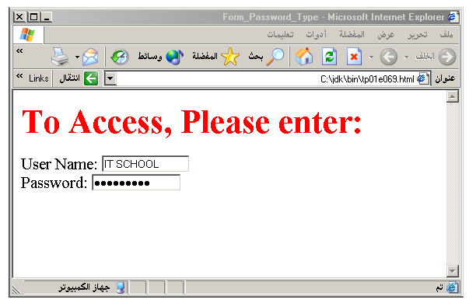
Output

Slide 46
Hidden
Hidden: Used to send data to the CGI application that you don’t want the web surfer to see, change or have to enter but is necessary for the application to process the form correctly.
<INPUT TYPE=“HIDDEN”>
Nothing is displayed in the browser.
Hidden inputs have the following attributes:
TYPE: hidden.
NAME: is the name of the variable to be sent to the CGI application.
VALUE: is usually set a value expected by the CGI application.

Slide 47
Check Box
Check Box: Check boxes allow the users to select more than one option.
<INPUT TYPE=“CHECKBOX”>
Browser will display
Checkboxes have the following attributes:
TYPE: checkbox.
CHECKED: is blank or CHECKED as the initial
status.
NAME: is the name of the variable to be sent to the
CGI application.
VALUE: is usually set to a value.

Slide 48
<HTML> <HEAD><TITLE>CheckBoxType</TITLE> </HEAD>
<BODY>
<h1> <font color=green>Please check one of the following</font></h1>
<FORM name="fome3" Action="url" method="get">
<font color=red> Select Country: </font><BR>
jordan:<INPUT TYPE="CheckBox" Name="country" CHECKED><BR>
Yemen<INPUT TYPE="CheckBox" Name="country"><BR>
Qatar:<INPUT TYPE="CheckBox" Name="country"><BR> <BR>
<font color=blue>Select Language:</font><BR>
Arabic:<INPUT TYPE="CheckBox" Name="language" CHECKED><BR> English:<INPUT TYPE="CheckBox" Name="language"><BR>
French:<INPUT TYPE="CheckBox" Name="language"> <BR></FORM> </BODY></HTML>

Slide 49
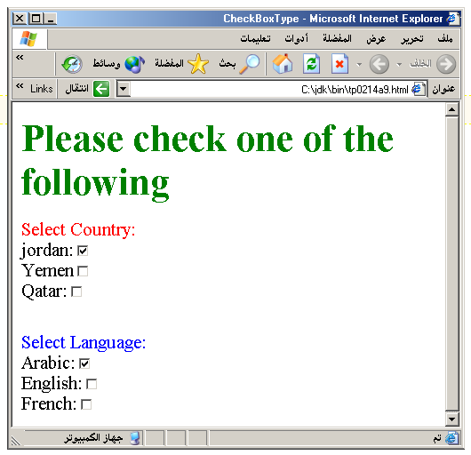
Output

Slide 50
Radio Button
Radio Button: Radio buttons allow the users to select
only one option.
<INPUT TYPE=“RADIO”>
Browser will display
Radio buttons have the following attributes:
TYPE: radio.
CHECKED: is blank or CHECKED as the initial
status. Only one radio button can be
checked
NAME: is the name of the variable to be sent to the
CGI application.
VALUE: usually has a set value.

Slide 51
<HTML> <HEAD><TITLE>CheckBoxType</TITLE> </HEAD>
<BODY>
<h1> <font color=green>Please check one of the following</font></h1>
<FORM name="fome3" Action="url" method="get">
<font color=red> Select Country: </font><BR>
jordan:<INPUT TYPE= "RADIO" Name="country" CHECKED><BR>
Yemen<INPUT TYPE="RADIO " Name="country"><BR>
Qatar:<INPUT TYPE="RADIO" Name="country"><BR> <BR>
<font color=blue>Select Language:</font><BR>
Arabic:<INPUT TYPE="RADIO" Name="language" CHECKED><BR> English:<INPUT TYPE=" RADIO " Name="language"><BR>
French:<INPUT TYPE=" RADIO " Name="language"> <BR></FORM> </BODY></HTML>

Slide 52
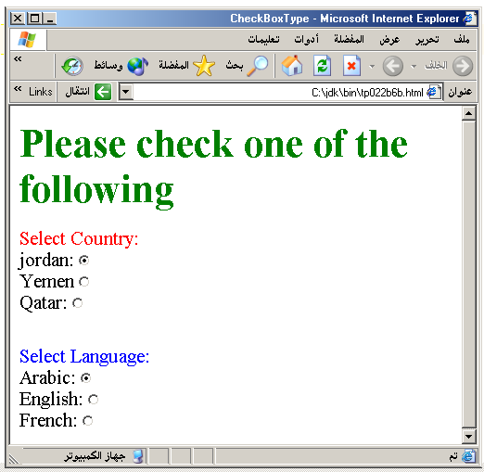

Slide 53
<HTML><HEAD>
<TITLE>RADIOBox</TITLE> </HEAD>
<BODY>
Form #1:
<FORM>
<INPUT TYPE="radio" NAME="choice" VALUE="one"> Yes.
<INPUT TYPE="radio" NAME="choice" VALUE="two"> No.
</FORM>
<HR color=red size="10" >
Form #2:
<FORM>
<INPUT TYPE="radio" NAME="choice" VALUE="three" CHECKED> Yes.
<INPUT TYPE="radio" NAME="choice" VALUE="four"> No.
</FORM>
</BODY></HTML>

Slide 54
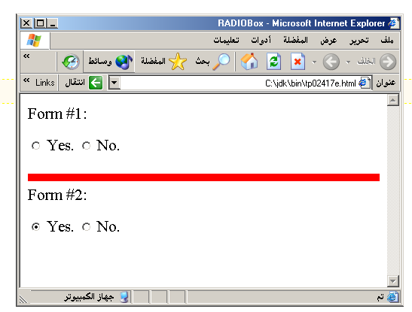
Output

Slide 55
Push Button
Push Button: This element would be used with
JavaScript to cause an action to take place.
<INPUT TYPE=“BUTTON”>
Browser will display
Push Button has the following attributes:
TYPE: button.
NAME: is the name of the button to be used
in scripting.
VALUE: determines the text label on the button.

Slide 56
<DIV align=center><BR><BR>
<FORM>
<FONT Color=red>
<h1>Press Here to see a baby crying:<BR>
<INPUT TYPE="button" VALUE="PressMe"><BR><BR>
<FONT Color=blue>
Click Here to see a baby shouting:<BR>
<INPUT TYPE="button" VALUE="ClickMe" > <BR><BR>
<FONT Color=green>
Hit Here to see a baby eating:<BR>
<INPUT TYPE="button" VALUE="HitME" > <BR><BR>
<FONT Color=yellow>
</FORM></DIV>

Slide 57
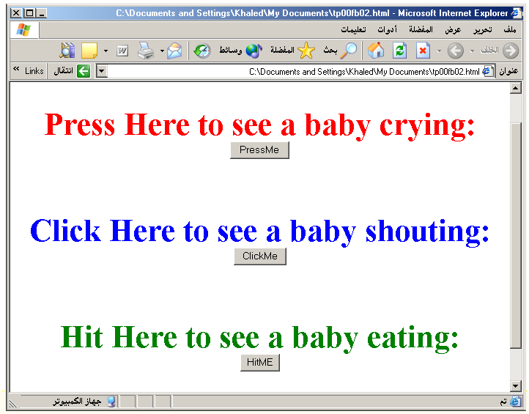

Slide 58
Submit Button
Submit: Every set of Form tags requires a Submit button. This is the element causes the browser to send the names and values of the other elements to the CGI Application specified by the ACTION attribute of the FORM element.
<INPUT TYPE=“SUBMIT”>
The browser will display
Submit has the following attributes:
TYPE: submit.
NAME: value used by the CGI script for processing.
VALUE: determines the text label on the button, usually Submit Query.

Slide 59
<FORM Action="URL" method="get">
First Name: <INPUT TYPE="TEXT" Size=25 name="firstName"><BR>
Family Name: <INPUT TYPE="TEXT" Size=25 name="LastName"><BR>
<BR>
<FONT Color=red>
Press Here to submit the data:<BR>
<INPUT TYPE="submit" VALUE="SubmitData " >
</FORM>

Slide 60
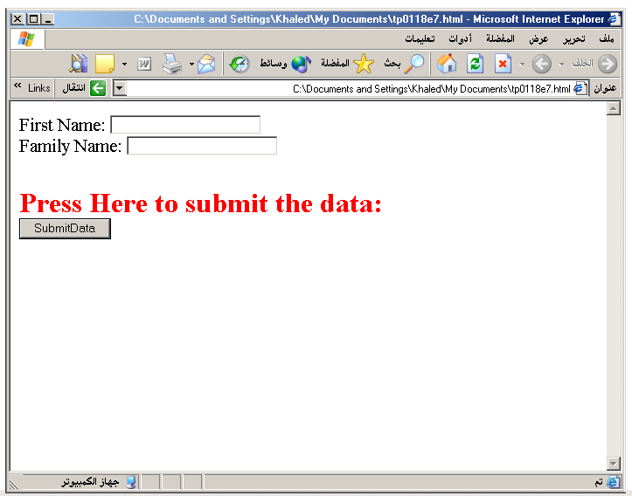

Slide 61
Reset Button
Reset: It is a good idea to include one of these for each form where users are entering data. It allows the surfer to clear all the input in the form.
<INPUT TYPE=“RESET”>
Browser will display
Reset buttons have the following attributes:
TYPE: reset.
VALUE: determines the text label on the button, usually Reset.

Slide 62
<FORM Action="URL" method="get">
First Name: <INPUT TYPE="TEXT" Size=25 name="firstName"> <BR>
Family Name: <INPUT TYPE="TEXT" Size=25 name="LastName"><BR>
<BR>
<FONT Color = red>
<STRONG><font size=5>Press Here to submit the data:</font></STRONG><BR>
<INPUT TYPE="submit" VALUE="SubmitData">
<INPUT TYPE="RESET" VALUE="Reset">
</FORM>

Slide 63
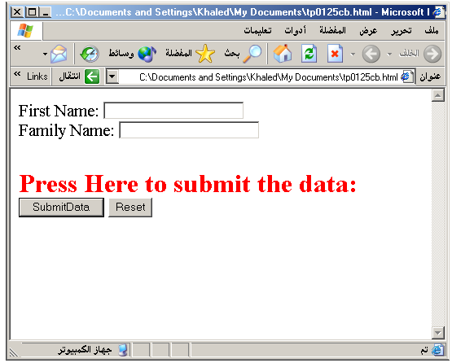

Slide 64
Image Submit Button
Image Submit Button: Allows you to substitute an image for the standard submit button.
<INPUT TYPE=“IMAGE” SRC=“jordan.gif”>
Image submit button has the following attributes:
TYPE: Image.
NAME: is the name of the button to be used in scripting.
SRC: URL of the Image file.

Slide 65
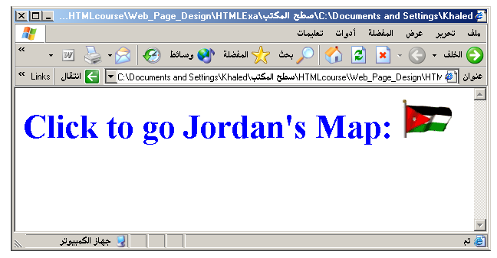
<form>
<H1><font color=blue>
Click to go Jordan’s Map:
<INPUT TYPE="IMAGE" SRC="jordan.gif">
</form>

Slide 66

File
File Upload: You can use a file upload to allow surfers to upload files to your web server.
<INPUT TYPE=“FILE”>
Browser will display
File Upload has the following attributes:
TYPE: file.
SIZE: is the size of the text box in characters.
NAME: is the name of the variable to be sent to the
CGI application.
MAXLENGHT: is the maximum size of the input in the
textbox in characters.

Slide 67
<BODY bgcolor=lightblue>
<form>
<H3><font color=forestgreen>
Please attach your file here to for uploading to
My <font color =red>SERVER...<BR>
<INPUT TYPE="File" name="myFile" size="30">
<INPUT TYPE="Submit" value="SubmitFile">
</form>
</BODY>

Slide 68
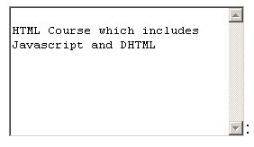
Other Elements used in Forms
<TEXTAREA></TEXTAREA>: is an element that allows for free form text entry.
Browser will display
Textarea has the following attributes:
NAME: is the name of the variable to be sent to the CGI application.
ROWS: the number of rows to the textbox.
COLS: the number of columns to the textbox.

Slide 69
<BODY bgcolor=lightblue>
<form>
<TEXTAREA COLS=40 ROWS=20 Name="comments" >
From observing the apathy of those
about me during flag raising I
concluded that patriotism if not
actually on the decline is at least
in a state of dormancy.
Written by Khaled Al-Fagih
</TEXTAREA>:
</form>
</BODY>

Slide 70
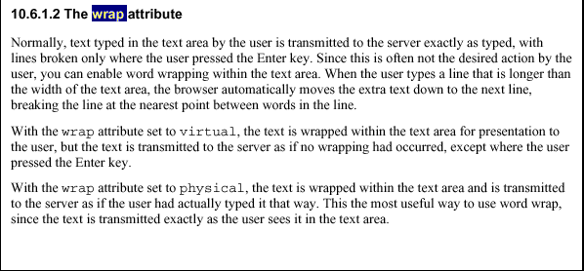

Slide 71
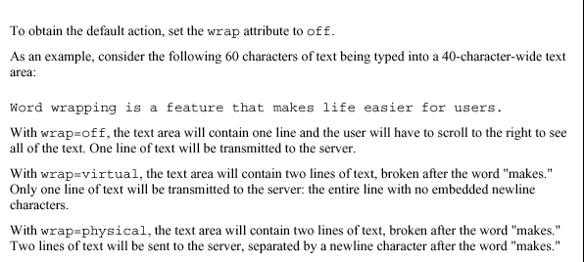

Slide 72
Other Elements used in Forms
The two following examples are <SELECT></SELECT> elements, where the attributes are set differently.
The Select elements attributes are:
NAME: is the name of the variable to be sent to the CGI application.
SIZE: this sets the number of visible choices.
MULTIPLE: the presence of this attribute signifies that the user can make multiple selections. By default only one selection is allowed.

Slide 73
<BODY bgcolor=lightblue>
<form>
Select the cities you have visited:
<SELECT name=“list” size=5>
<option> London</option>
<option> Tokyo</option>
<option> Paris</option>
<option> New York</option>
<option> LA</option>
<option> KL</option>
</SELECT>
</form>
</BODY>

Slide 74
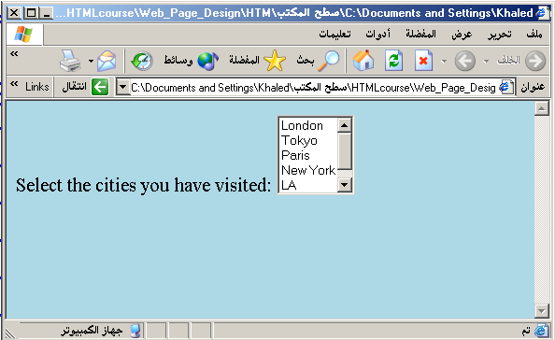

Slide 75
Other Elements used in Forms
Drop Down List:
Name: is the name of the variable to be sent to the CGI application.
Size: 1.

Slide 76

Other Elements used in Forms
List Box:
Name: is the name of the variable to be sent to the CGI application.
SIZE: is greater than one.

Slide 77
Other Elements used in Forms
Option
The list items are added to the <SELECT> element by inserting <OPTION></OPTION> elements.
The Option Element’s attributes are:
SELECTED: When this attribute is present, the option is selected when the document is initially loaded. It is an error for more than one option to be selected.
VALUE: Specifies the value the variable named in the select element.

Slide 78
</HEAD>
<BODY>
<h2><font color=blue>What type of Computer do you have?</font><h2>
<FORM>
<SELECT NAME="ComputerType" size=4>
<OPTION value="IBM" SELECTED> IBM</OPTION>
<OPTION value="INTEL"> INTEL</OPTION>
<OPTION value=" Apple"> Apple</OPTION>
<OPTION value="Compaq"> Compaq</OPTION>
</SELECT>
</FORM></BODY></HTML>

Slide 79
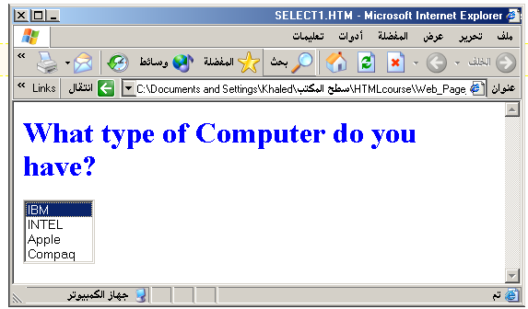

Slide 80
<HEAD> <TITLE>SELECT with Mutiple </TITLE> </HEAD>
<BODY>
<h2><font color=blue>What type of Computer do you have?</font><h2>
<FORM>
<SELECT NAME="ComputerType" size=5 multiple>
<OPTION value="IBM" > IBM</OPTION>
<OPTION value="INTEL"> INTEL</OPTION>
<OPTION value=" Apple"> Apple</OPTION>
<OPTION value="Compaq" SELECTED> Compaq</OPTION>
<OPTION value=" other"> Other</OPTION>
</SELECT>
</FORM></BODY></HTML>

Slide 81
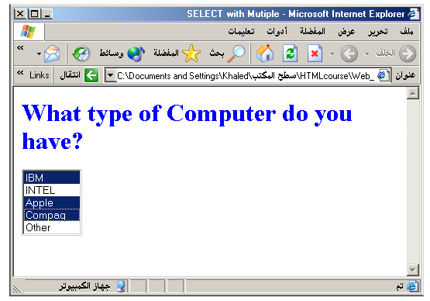

Slide 82
